Slide 1

Chapter 4 – Machine Learning with Graphs II
Prepared by: Shier Nee, SAW

Slide 2
Announcement
31 Dec 2021 - Week 10
  Proposal submission
  Asynchronous
Notes:
Uni – 45 min, multi – 30min, break (15min), statistic – 1.5hr

Slide 3
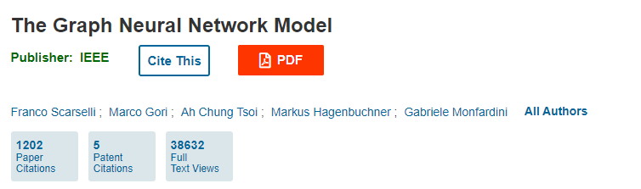
History
GNN was introduced back in 2005
First paper published in 2008.
Started to gain popularity in the past 5 years because it able to model relationship between nodes and produce numeric representation of it.
GNN originates from two ML techniques: recursive neural network and Markov chains.
Idea: encode data using graph and exploit relationship between nodes.

Slide 4
Why do we need Graph Neural Network
Conventional NN is designed for simple sequences and grids (rigid)
More flexible
Allow to investigate interaction between nodes / relationship between nodes
Shown to be more generalizable
Many real world data can be represented as graph.

Slide 5
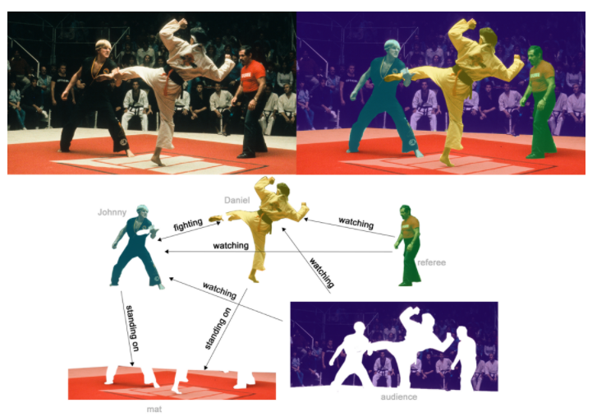
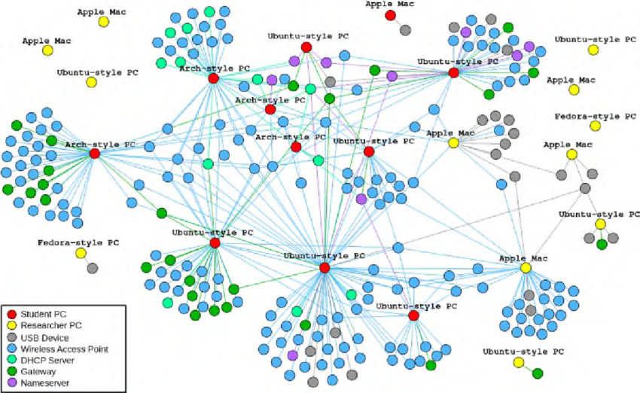
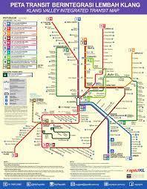
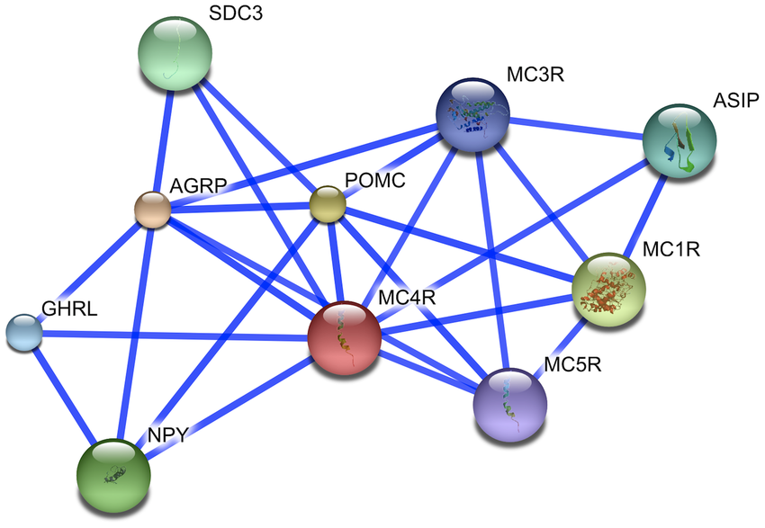
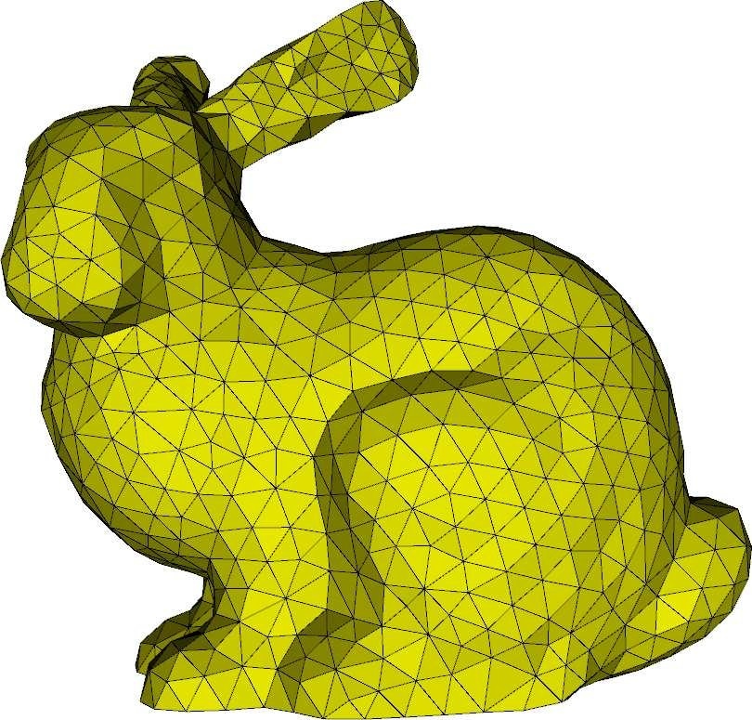
Representation of Real-World Data as Graph
Social Network Graph
Scene Graph
Transportation Network Graph
Molecule Network Graph
Geometric Network Graph

Slide 6
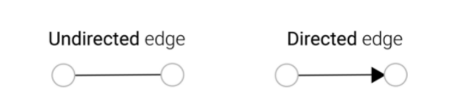
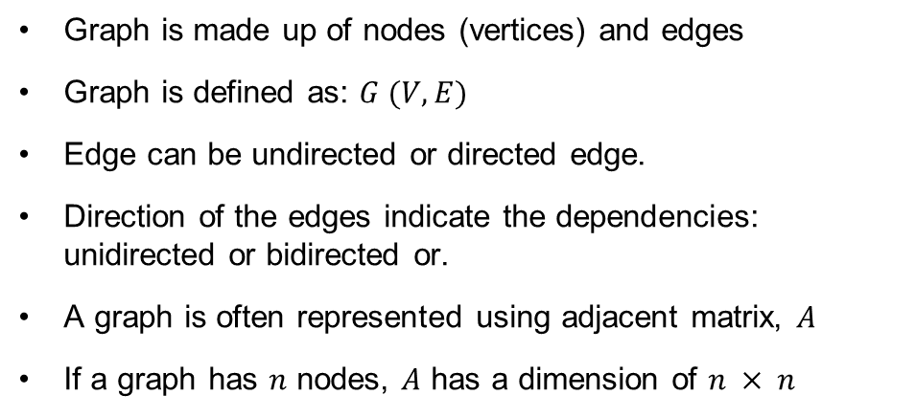
Graph Neural Network
Graph is made up of nodes (vertices) and edges
Graph is defined as: $G (V, E)$
Edge can be undirected or directed edge.
Direction of the edges indicate the dependencies: unidirected or bidirected or.
A graph is often represented using adjacent matrix, $A$
If a graph has $n$ nodes, $A$ has a dimension of $n × n$
Flexible but also mean it is harder to build
Figure form https://neptune.ai/blog/graph-neural-network-and-some-of-gnn-applications

Slide 7
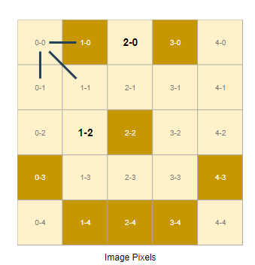
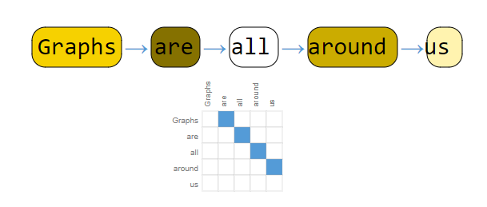
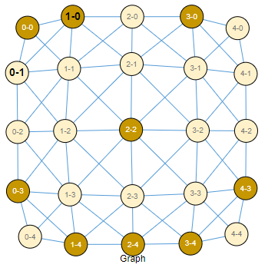
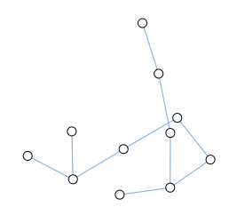
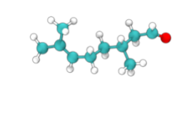
Graph Neural Network
Image as Graph
Text as Graph
Molecules as Graph
Figure from https://distill.pub/2021/gnn-intro/

Slide 8
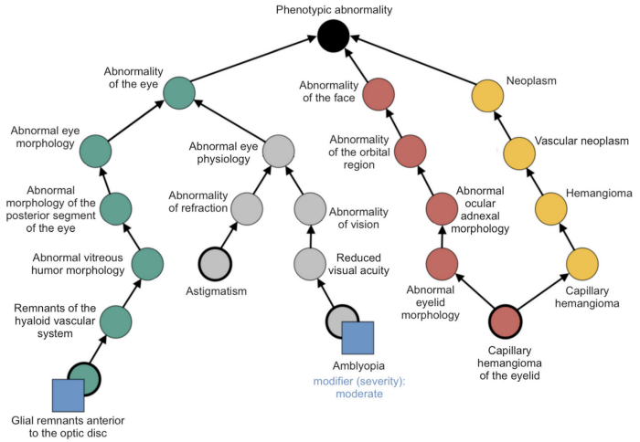
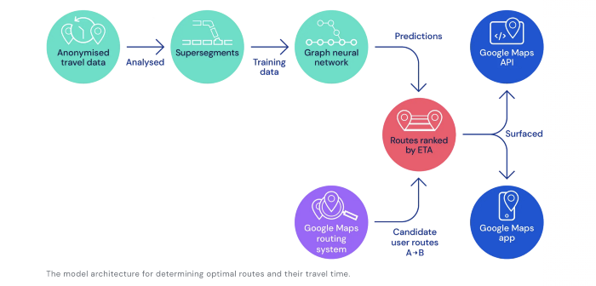
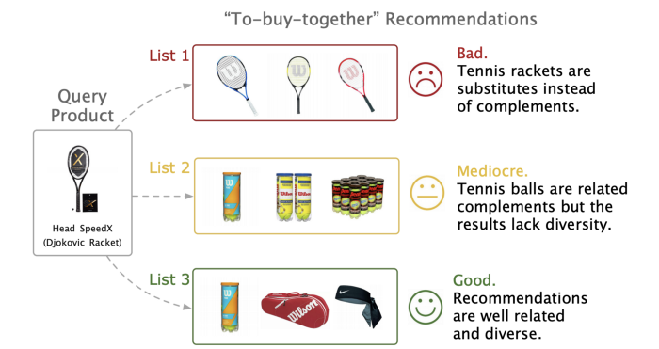
Applications Graph Neural Network
Medical Diagnosis & Electronic Health Records Modeling
Traffic forecasting
Recommendation System
Figure form https://jonathan-hui.medium.com/applications-of-graph-neural-networks-gnn-d487fd5ed17d

Slide 9
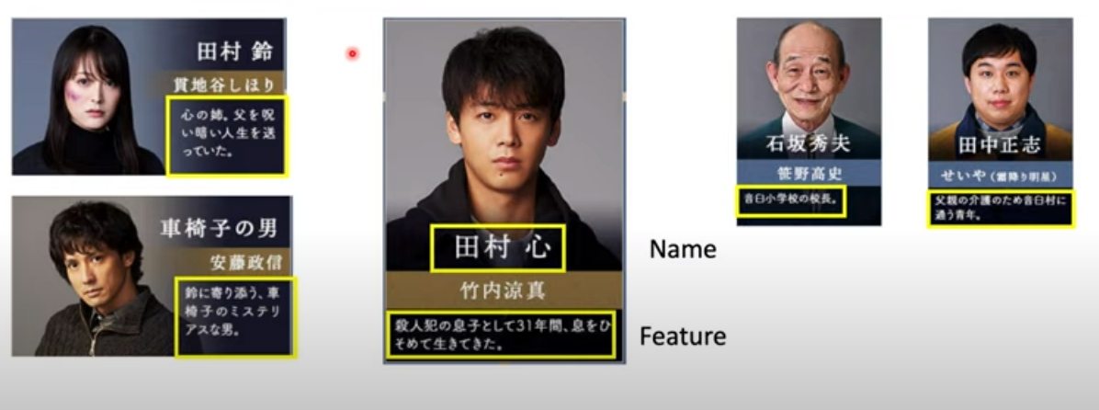
Basic idea of Classifier
Features
Classifier
Who is the murder?
From https://www.youtube.com/watch?v=eybCCtNKwzA&ab_channel=Hung-yiLee

Slide 10
GNN
Features
Classifier
Who is the murder?
Sister- brother
Husband-wife
colleague
Teacher-student
Neighbour
From https://www.youtube.com/watch?v=eybCCtNKwzA&ab_channel=Hung-yiLee

Slide 11


Convolutional Neural Network (CNN)
CNN
$\left[\begin{matrix}1 & 0 & 1 \\ 1 & 1 & 1 \\ 0 & 0 & 0\end{matrix}\right]∙\left[\begin{matrix}1 & 0 & 1 \\ 1 & 0 & 1 \\ 1 & 0 & 1\end{matrix}\right]$ = 4
1 | 0 | 1 | 1 | 0 | 1
1 | 1 | 1 | 1 | 1 | 0
0 | 0 | 0 | 1 | 1 | 1
0 | 0 | 1 | 1 | 1 | 0
1 | 1 | 1 | 1 | 0 | 0
0 | 1 | 0 | 1 | 0 | 0
4
Convolution
3x3 kernel
W=$\left[\begin{matrix}1 & 0 & 1 \\ 1 & 0 & 1 \\ 1 & 0 & 1\end{matrix}\right]$
Layer i
Layer i+1

Slide 12

CNN
CNN
$\left[\begin{matrix}0 & 1 & 1 \\ 1 & 1 & 1 \\ 0 & 0 & 1\end{matrix}\right]∙\left[\begin{matrix}1 & 0 & 1 \\ 1 & 0 & 1 \\ 1 & 0 & 1\end{matrix}\right]$ = 4
1 | 0 | 1 | 1 | 0 | 1
1 | 1 | 1 | 1 | 1 | 0
0 | 0 | 0 | 1 | 1 | 1
0 | 0 | 1 | 1 | 1 | 0
1 | 1 | 1 | 1 | 0 | 0
0 | 1 | 0 | 1 | 0 | 0
4 | 4
Convolution
3x3 kernel
W=$\left[\begin{matrix}1 & 0 & 1 \\ 1 & 0 & 1 \\ 1 & 0 & 1\end{matrix}\right]$
Layer i
Layer i+1

Slide 13

CNN
CNN
$\left[\begin{matrix}1 & 1 & 0 \\ 1 & 1 & 1 \\ 0 & 1 & 1\end{matrix}\right]∙\left[\begin{matrix}1 & 0 & 1 \\ 1 & 0 & 1 \\ 1 & 0 & 1\end{matrix}\right]$ = 4
1 | 0 | 1 | 1 | 0 | 1
1 | 1 | 1 | 1 | 1 | 0
0 | 0 | 0 | 1 | 1 | 1
0 | 0 | 1 | 1 | 1 | 0
1 | 1 | 1 | 1 | 0 | 0
0 | 1 | 0 | 1 | 0 | 0
4 | 4 | 4
Convolution
3x3 kernel
W=$\left[\begin{matrix}1 & 0 & 1 \\ 1 & 0 & 1 \\ 1 & 0 & 1\end{matrix}\right]$
Layer i
Layer i+1

Slide 14

CNN
CNN
$\left[\begin{matrix}1 & 0 & 1 \\ 1 & 1 & 0 \\ 1 & 1 & 1\end{matrix}\right]∙\left[\begin{matrix}1 & 0 & 1 \\ 1 & 0 & 1 \\ 1 & 0 & 1\end{matrix}\right]$ = 5
1 | 0 | 1 | 1 | 0 | 1
1 | 1 | 1 | 1 | 1 | 0
0 | 0 | 0 | 1 | 1 | 1
0 | 0 | 1 | 1 | 1 | 0
1 | 1 | 1 | 1 | 0 | 0
0 | 1 | 0 | 1 | 0 | 0
4 | 4 | 4 | 5
Convolution
3x3 kernel
W=$\left[\begin{matrix}1 & 0 & 1 \\ 1 & 0 & 1 \\ 1 & 0 & 1\end{matrix}\right]$
Layer i
Layer i+1

Slide 15
CNN
CNN
1 | 0 | 1 | 1 | 0 | 1
1 | 1 | 1 | 1 | 1 | 0
0 | 0 | 0 | 1 | 1 | 1
0 | 0 | 1 | 1 | 1 | 0
1 | 1 | 1 | 1 | 0 | 0
0 | 1 | 0 | 1 | 0 | 0
Repeat the rest
4 | 4 | 4 | 5
4 | 4 | 5 | 4
3 | 3 | 4 | 4
3 | 5 | 3 | 3
Convolution
3x3 kernel
W=$\left[\begin{matrix}1 & 0 & 1 \\ 1 & 0 & 1 \\ 1 & 0 & 1\end{matrix}\right]$
Feature extraction
Layer i
Layer i+1

Slide 16
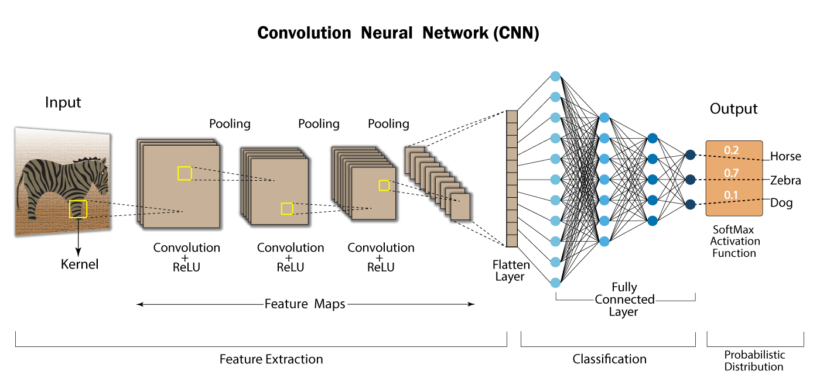
CNN
From https://developersbreach.com/convolution-neural-network-deep-learning/

Slide 17

GNN
How to embed node into a feature space using convolution?
1 | 0 | 1 | 1 | 0 | 1
1 | 1 | 1 | 1 | 1 | 0
0 | 0 | 0 | 1 | 1 | 1
0 | 0 | 1 | 1 | 1 | 0
1 | 1 | 1 | 1 | 0 | 0
0 | 1 | 0 | 1 | 0 | 0
Not trivial
No fixed node ordering or reference point
Arbitrary size and complex topological structure

Slide 18
GNN
Approach1: Spatial-based convolution (same idea as CNN)
Approach2: Spectral-based convolution (same idea as convolution in signal processing)

Slide 19
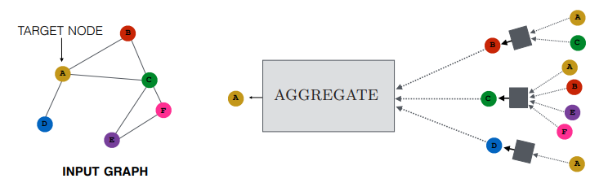
Spatial-based convolution
Aggregate local network neighbourhoods:
Sum
Mean
Weighted sum
LSTM
Max pooling
Message Passing
Figure from https://www.cs.mcgill.ca/~wlh/grl_book/files/GRL_Book-Chapter_5-GNNs.pdf

Slide 20
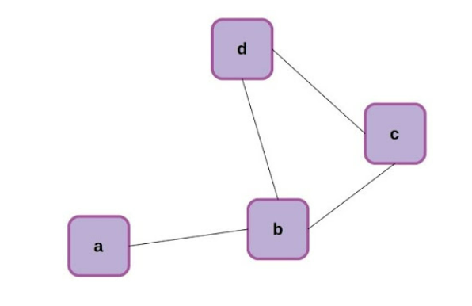


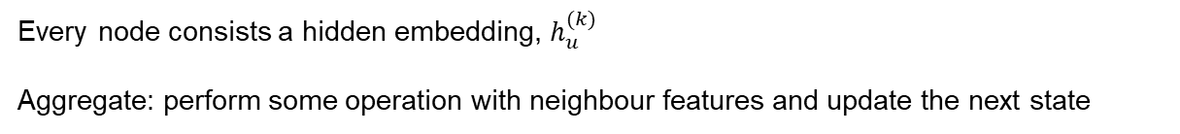

Spatial-based convolution
Aggregation
Aggregation
$$h_{2}^{(2)}$$
$$h_{2}^{(3)}$$
$$h_{2}^{(1)}$$
Every node consists a hidden embedding, $h_{u}^{(k)}$
Aggregate: perform some operation with neighbour features and update the next state

Slide 21
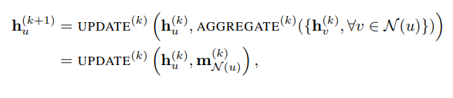














Aggregation: Sum
Input Layer
Hidden Layer 0
Hidden Layer 1
$$h_{3}^{(0)}$$
$$h_{3}^{(1)}$$
$$x_{4}$$
$$h_{2}^{(0)}$$
$$h_{2}^{(1)}$$
$$x_{3}$$
$$x_{2}$$
$$h_{0}^{(0)}$$
$$h_{1}^{(0)}$$
$$h_{0}^{(1)}$$
$$h_{1}^{(1)}$$
$$x_{1}$$
$$h_{2}^{(0)}={\overline{w}}_{0}(x_{2})$$
$$h_{2}^{(1)}={\hat{w}}_{1,0}\left(h_{1}^{0}+h_{3}^{0}\right)+{\overline{w}}_{0}(x_{2})$$
m = message passing

Slide 22
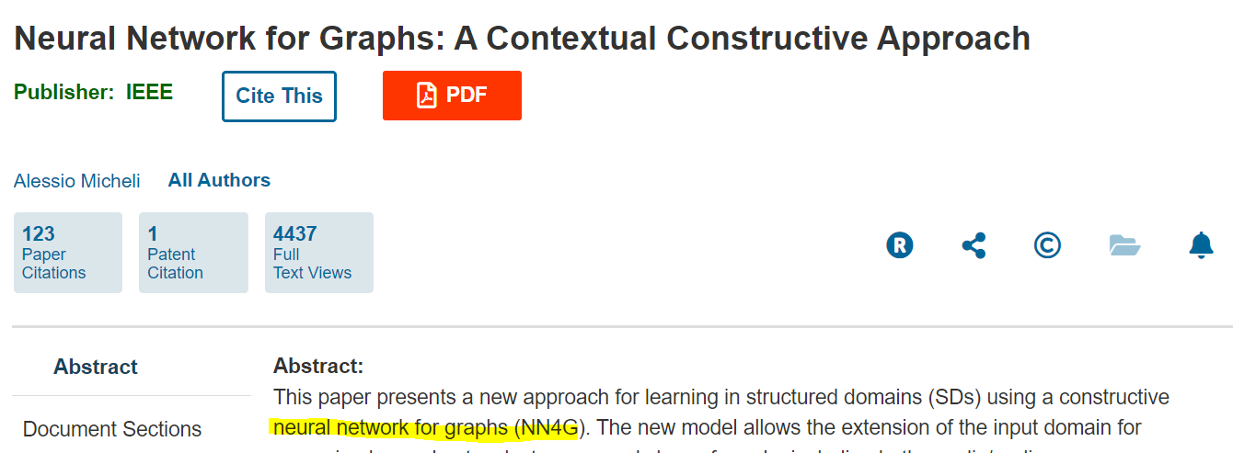



Aggregation: Sum
Input Layer
Hidden Layer 0
Hidden Layer 1
$$h_{3}^{(0)}$$
$$h_{3}^{(1)}$$
$$x_{4}$$
$$h_{2}^{(0)}$$
$$h_{2}^{(1)}$$
$$x_{3}$$
$$x_{2}$$
$$h_{0}^{(0)}$$
$$h_{1}^{(0)}$$
$$h_{0}^{(1)}$$
$$h_{1}^{(1)}$$
$$x_{1}$$
NN4G (Neural Network for Graph)
https://ieeexplore.ieee.org/document/4773279
$$h_{1}^{(0)}={\hat{w}}_{0}(x_{1})$$
$$h_{1}^{(1)}={\hat{w}}_{1,0}(h_{0}^{0}+h_{2}^{0}+h_{3}^{0})$$

Slide 23



Aggregation: Mean
Input Layer
Hidden Layer 0
$$h_{3}^{(0)}$$
$$x_{4}$$
$$h_{2}^{(0)}$$
$$x_{3}$$
$$h_{0}^{(0)}$$
$$h_{1}^{(0)}$$
$$x_{1}$$
$$x_{2}$$
$$h_{1}^{(0)}=w_{3}^{0}MEAN\left(d\left(3, :\right)=1\right)$$
d = distance

Slide 24

Aggregation: Mean
Input Layer
Hidden Layer 0
Hidden Layer 1
$$h_{3}^{(0)}$$
$$h_{3}^{(1)}$$
$$x_{4}$$
$$h_{2}^{(0)}$$
$$h_{2}^{(1)}$$
$$x_{3}$$
$$h_{0}^{(0)}$$
$$h_{1}^{(0)}$$
$$h_{0}^{(1)}$$
$$h_{1}^{(1)}$$
$$x_{1}$$
$$x_{2}$$
$$h_{1}^{(1)}=w_{3}^{1}MEAN(d\left(3, :\right)=2)$$
$$h_{1}^{(0)}=w_{3}^{0}MEAN\left(d\left(3, :\right)=1\right)$$
By having many hidden layer, we can extract the relationship between nodes from far.
d = distance

Slide 25
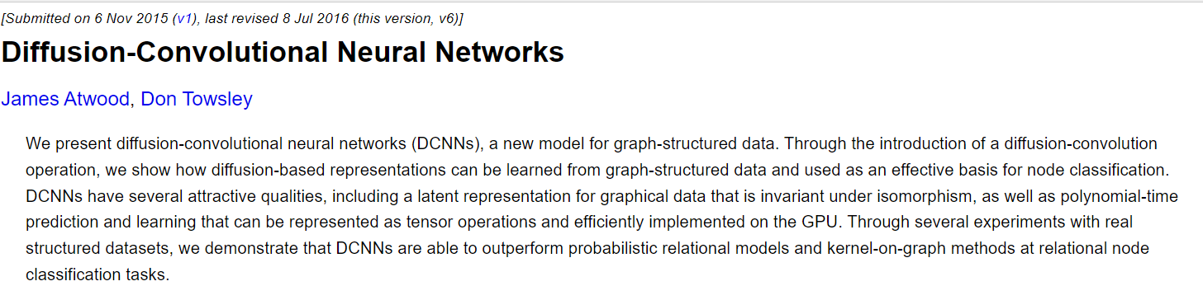
Aggregation: Mean
Input Layer
Hidden Layer 0
Hidden Layer 1
$$h_{3}^{(0)}$$
$$h_{3}^{(1)}$$
$$x_{4}$$
$$h_{2}^{(0)}$$
$$h_{2}^{(1)}$$
$$x_{3}$$
$$h_{0}^{(0)}$$
$$h_{1}^{(0)}$$
$$h_{0}^{(1)}$$
$$h_{1}^{(1)}$$
$$x_{1}$$
$$x_{2}$$
$$h_{1}^{(1)}=w_{3}^{1}MEAN(d\left(3, :\right)=2)$$
DCNN (Diffusion-Convolutional Neural Network)
https://arxiv.org/abs/1511.02136
$$h_{1}^{(0)}=w_{3}^{0}MEAN\left(d\left(3, :\right)=1\right)$$
By having many hidden layer, we can extract the relationship between nodes from far.
d = distance

Slide 26




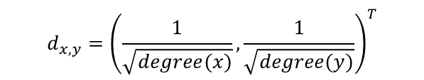





Aggregation: Weighted Sum
Take into account the interaction of the neighbour's nodes
Hidden Layer 0
Hidden Layer 1
$$h_{3}^{(0)}$$
$$d_{2,3}$$
$$h_{3}^{(1)}$$
$$h_{2}^{(0)}$$
$$h_{2}^{(1)}$$
$$d_{1,2}$$
$$h_{0}^{(0)}$$
$$h_{1}^{(0)}$$
$$h_{0}^{(1)}$$
$$h_{1}^{(1)}$$
$$d_{x,y}={\left(\frac{1}{\sqrt{degree(x)}},\frac{1}{\sqrt{degree(y)}}\right)}^{T}$$
$$h_{1}^{(1)}=w\left(d_{1,2}\right)×h_{1}^{(0)}+w\left(d_{2,3}\right)×h_{3}^{(0)}$$
d = distance
degree = degree of node (connect to how many node)

Slide 27
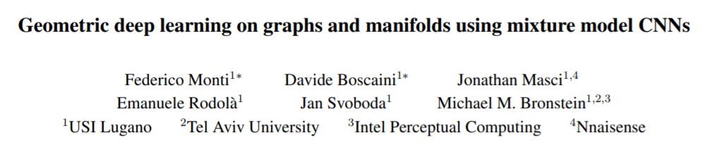



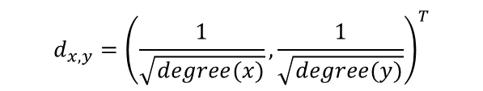





Aggregation: Weighted Sum
Hidden Layer 0
Hidden Layer 1
$$h_{3}^{(0)}$$
$$d_{2,3}$$
$$h_{3}^{(1)}$$
$$h_{2}^{(0)}$$
$$h_{2}^{(1)}$$
$$d_{1,2}$$
$$h_{0}^{(0)}$$
$$h_{1}^{(0)}$$
$$h_{0}^{(1)}$$
$$h_{1}^{(1)}$$
$$d_{x,y}={\left(\frac{1}{\sqrt{degree(x)}},\frac{1}{\sqrt{degree(y)}}\right)}^{T}$$
$$h_{1}^{(1)}=w\left(d_{1,2}\right)×h_{1}^{(0)}+w\left(d_{2,3}\right)×h_{3}^{(0)}$$
MoNET (Mixture Model Network)
https://arxiv.org/pdf/1611.08402.pdf
Take into account the distance of the nodes for its effect
d = distance
degree = degree of node (connect to how many node)

Slide 28
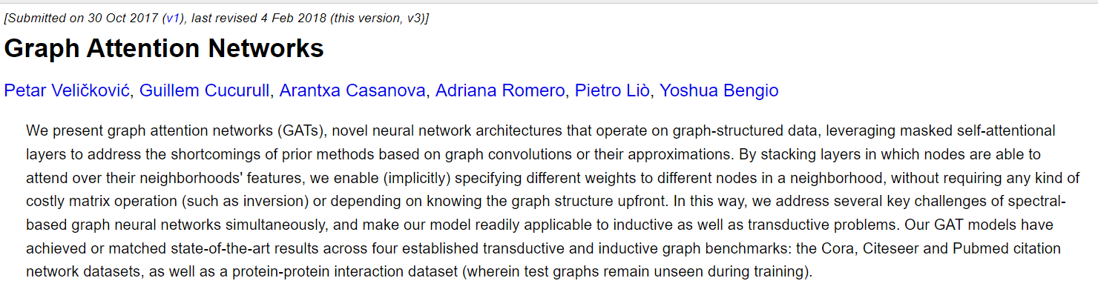
Aggregation: Weighted Sum
Useful strategy for increasing the representational capacity of a GNN model, especially in cases where you have prior knowledge to indicate that some neighbors might be more informative than others

Slide 29
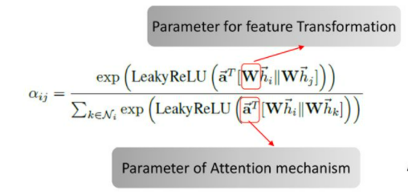
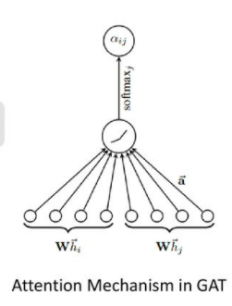

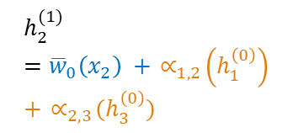


Aggregation: Weighted Sum
Hidden Layer 0
Hidden Layer 1
$$h_{2}^{(1)}={\overline{w}}_{0}\left(x_{2}\right) +{ ∝}_{1,2}\left(h_{1}^{\left(0\right)}\right)+{ ∝}_{2,3}(h_{3}^{\left(0\right)})$$
$$h_{3}^{(0)}$$
$$∝_{2,3}$$
$$h_{3}^{(1)}$$
$$h_{2}^{(0)}$$
$$h_{2}^{(1)}$$
$$∝_{1,2}$$
$$h_{0}^{(0)}$$
$$h_{1}^{(0)}$$
$$h_{0}^{(1)}$$
$$h_{1}^{(1)}$$
$∝$ = attention on neighbour

Slide 30
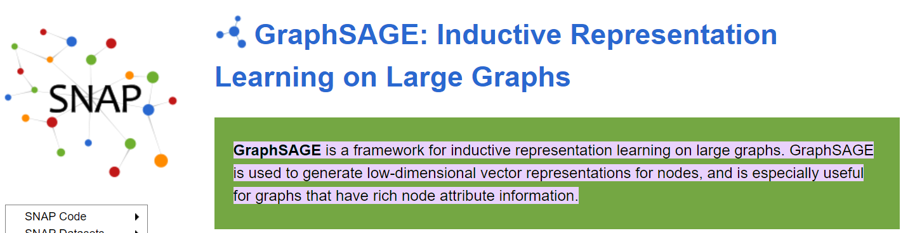
Spatial-based convolution
Aggregate local network neighbourhoods:
Sum
Mean
Weighted sum
LSTM
Max pooling

Slide 31
Types of prediction tasks on graphs
Graph-level → predict a single property for a whole graph
Node-level → predict some property for each node in a graph
Edge-level → predict the property or presence of edges in a graph

Slide 32
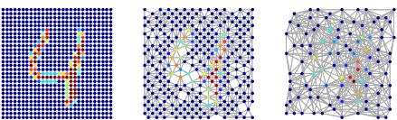
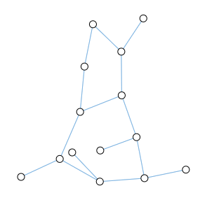
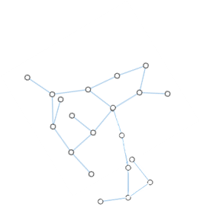
Graph Level Prediction
Predict whether it binds to certain receptor – implicate diseases?
Image Classification – MNIST
Text Analysis
Based on the text using graph, we predict type of moods → happy / sad / depression / excited
Figure form https://www.researchgate.net/publication/308716386_Graph_Based_Convolutional_Neural_Network/figures?lo=1&utm_source=google&utm_medium=organic

Slide 33
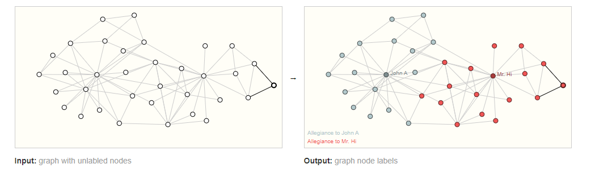
Node Level Prediction
Predict category / property of the node.
Example: Zach’s Karate club [1] – predict loyalty of member to either John A. or Mr. Hi.
Node represents member in Karate club and edge represent interaction between members.
[1] http://www1.ind.ku.dk/complexLearning/zachary1977.pdf

Slide 34
Node Level Prediction
With image, image segmentation is an example where we are trying to label the role of each pixel in an image.
  With text, a similar task would be predicting the parts-of-speech of each word in a sentence (e.g. noun, verb, adverb, etc).
[1] http://www1.ind.ku.dk/complexLearning/zachary1977.pdf

Slide 35
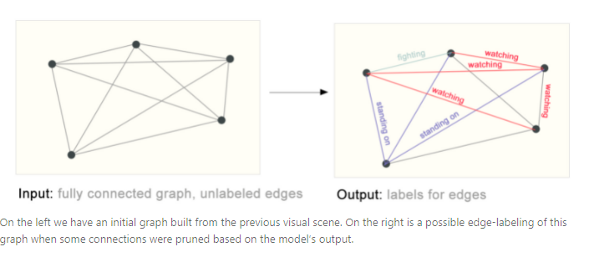
Edge Level Prediction
Image scene understanding - predict the relationship between nodes.
[1] https://distill.pub/2021/gnn-intro/

Slide 36
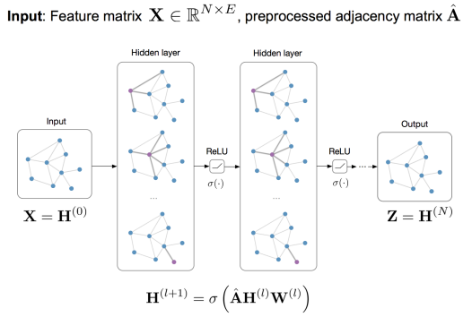
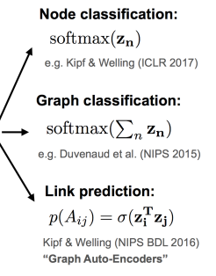

Classification
Adjacent matrix, $A$

Slide 37
GNN
We have learn about the graphical concept about GNN
How are we going to represent the graphical concept (node/edge) into computer that is understandable by computer
If you notice, all of these are matrix computation
One thing to note, we have to represent the graph in an efficient way for matrix operation.

Slide 38


Node embedding
Task: Map nodes to embedding space
Encode network information
Similarity of embeddings between nodes indicates their similarity in the network (i.e. Both nodes are close to each other (connected by an edge))
Potentially used for many downstream predictions
node
vector
$$u$$
$$f:u→ℝ^{d}$$
$$\text{Feature} \text{representation}\text{, }\text{embedding}$$

Slide 39
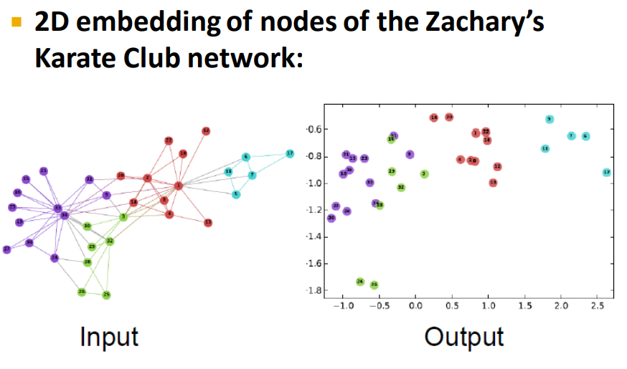
Node embedding
From http://web.stanford.edu/class/cs224w/slides/03-nodeemb.pdf

Slide 40
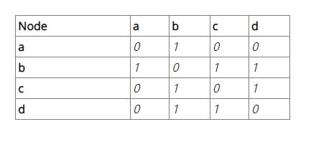
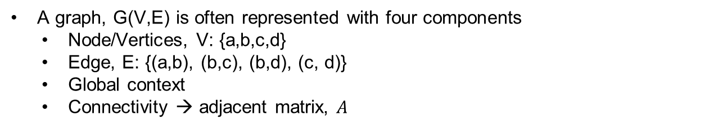

Graph
A graph, G(V,E) is often represented with four components
  Node/Vertices, V: {a,b,c,d}
  Edge, E: {(a,b), (b,c), (b,d), (c, d)}
  Global context
  Connectivity → adjacent matrix, $A$
Adjacent matrix, $A$
Figure form https://www.kdnuggets.com/2020/11/friendly-introduction-graph-neural-networks.html

Slide 41

Node embedding
Enc(c)
z(c)
Encode node
z(b)
Enc(b)
Original network
Embedding space
Goal: To encode nodes so that similarity in the embedding space (e.g., dot product) approximates similarity in the graph
$$Similarity(c,b) ≈z_{c}^{T}z_{b}$$

Slide 42
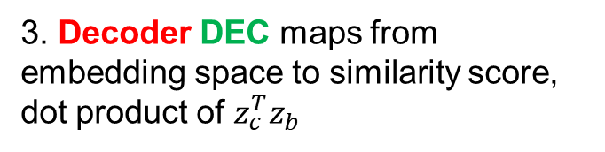
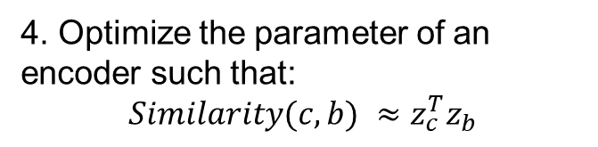
Learning node embedding
1. Encoder maps from nodes to embeddings
2. Define a node similarity function:
specifies how the relationships in vector space map to the relationships in the original network
Enc(c)
3. Decoder DEC maps from embedding space to similarity score, dot product of $z_{c}^{T}z_{b}$
z(c)
z(b)
Enc(b)
Original network
Embedding space
4. Optimize the parameter of an encoder such that:
$Similarity(c,b) ≈z_{c}^{T}z_{b}$

Slide 43
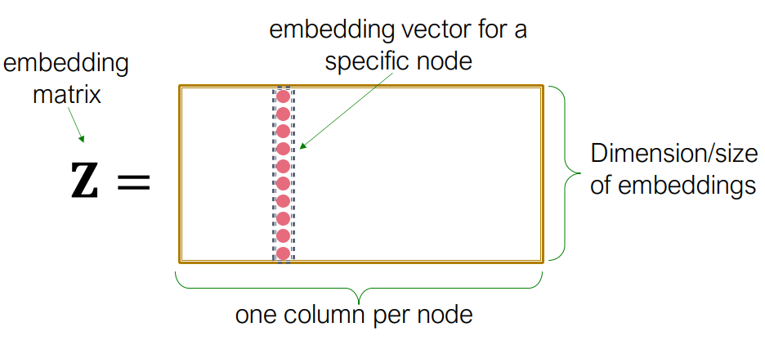
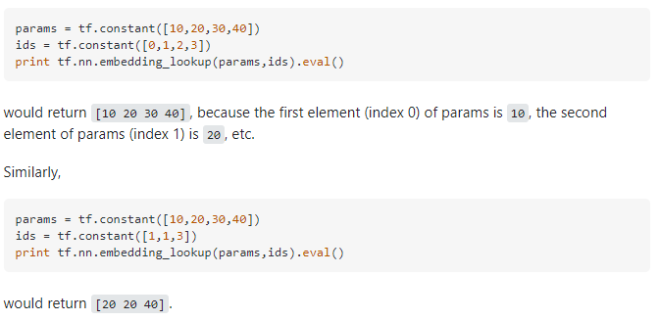
“Shallow” Encoding
Simplest encoding approach: embedding-lookup

Slide 44
“Shallow” Encoding
Simplest encoding approach: embedding-lookup
Each node is assigned a unique embedding vector (i.e., we directly optimize the embedding of each node)

Slide 45
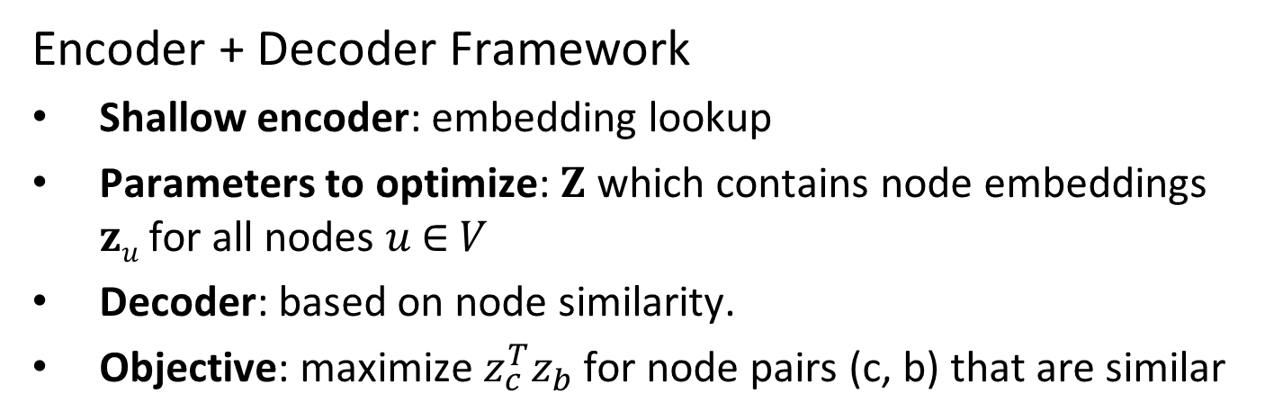
Framework
Encoder + Decoder Framework
Shallow encoder: embedding lookup
Parameters to optimize: 𝐙 which contains node embeddings 𝐳_{𝑢} for all nodes 𝑢 ∈ 𝑉
Decoder: based on node similarity.
Objective: maximize $z_{c}^{T}z_{b}$ for node pairs (c, b) that are similar

Slide 46
Framework
Encoder + Decoder Framework
Shallow encoder: embedding lookup
Parameters to optimize: 𝐙 which contains node embeddings 𝐳_{𝑢} for all nodes 𝑢 ∈ 𝑉
Decoder: based on node similarity.
Objective: maximize $z_{c}^{T}z_{b}$ for node pairs (c, b) that are similar

Slide 47
Your Task
Draw a flow chart and write the description of the Neural Network training process in your own words
Submit Week6 – Clustering Lab
Deadline by 24 Dec 2021

Slide 48
References
https://distill.pub/2021/gnn-intro/
https://neptune.ai/blog/graph-neural-network-and-some-of-gnn-applications
https://towardsdatascience.com/an-introduction-to-graph-neural-network-gnn-for-analysing-structured-data-afce79f4cfdc
https://www.cs.ubc.ca/~lsigal/532S_2018W2/Lecture18a.pdf
http://web.stanford.edu/class/cs224w/slides/06-GNN1.pdf

